Slide 1

ASSIGNMENT ON CREATING A CHATBOT TO SUPPORT STUDENT SELECTING A COURSE IN KEONICS
By Group 4:
Harish H K
Supriya M K
Gourav P
Assignment for
Sabyasachi B
GUIDED BY
MOHAMMAD TAHIR MIRJI
L2 KTC Hubli

Slide 2
What is chatbot
A chat robot a computer program that simulates human conversation or chat through artificial intelligence.
It is a service , powered by rules and artificial intelligence , that you interact with via a chat interface.

Slide 3
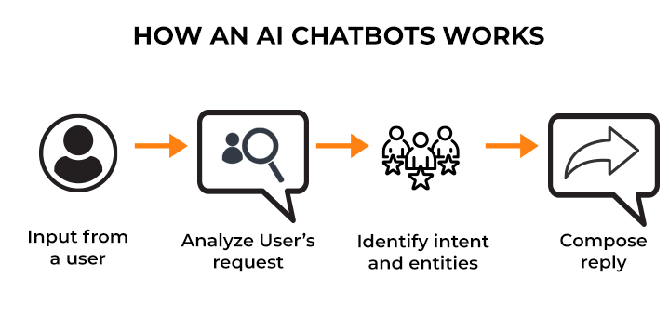
HOW CHATBOT WORKS

Slide 4
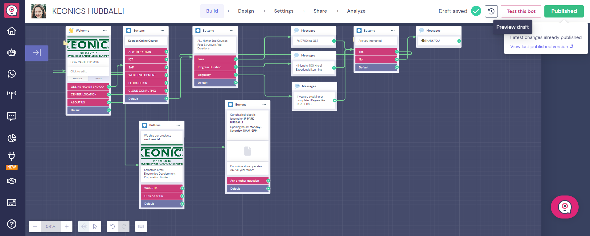
THIS IS HOW OUR CHATBOT LOOKS

Slide 5
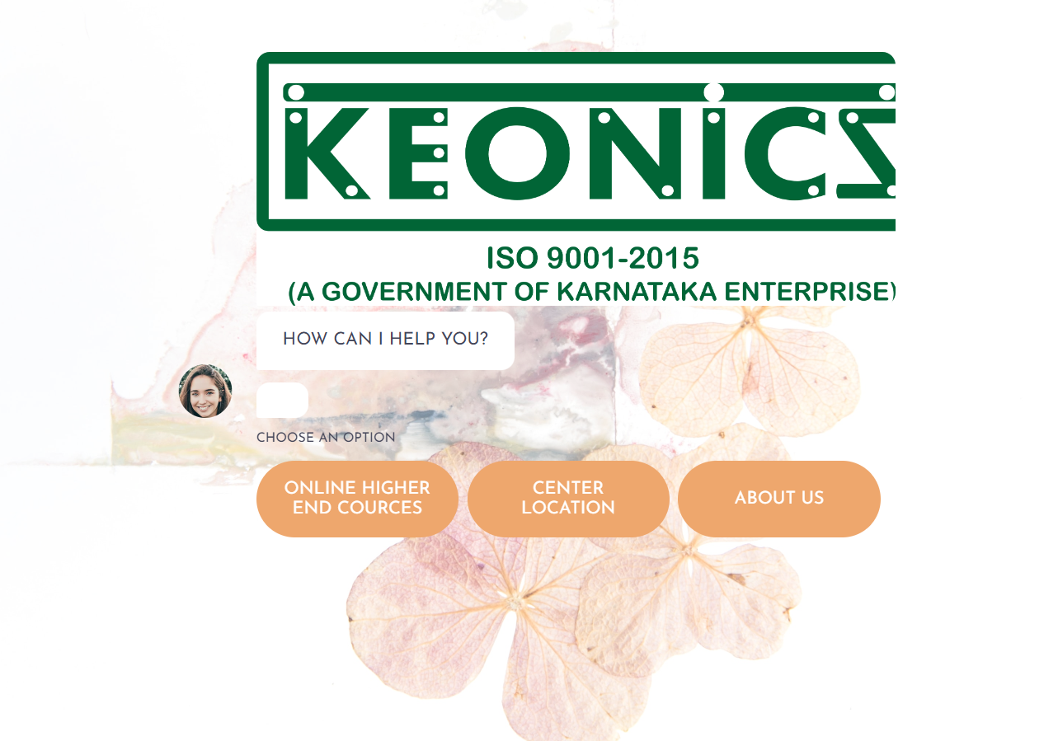
CHATBOT DIALOGUE FLOW
This Is How We Gave The Options If They Want To Know About Course They Can Click On Online Higher End Courses
Also They Can Trace The Location By Clicking On Center Location If They Want More Information Then They Can Click On About Us

Slide 6
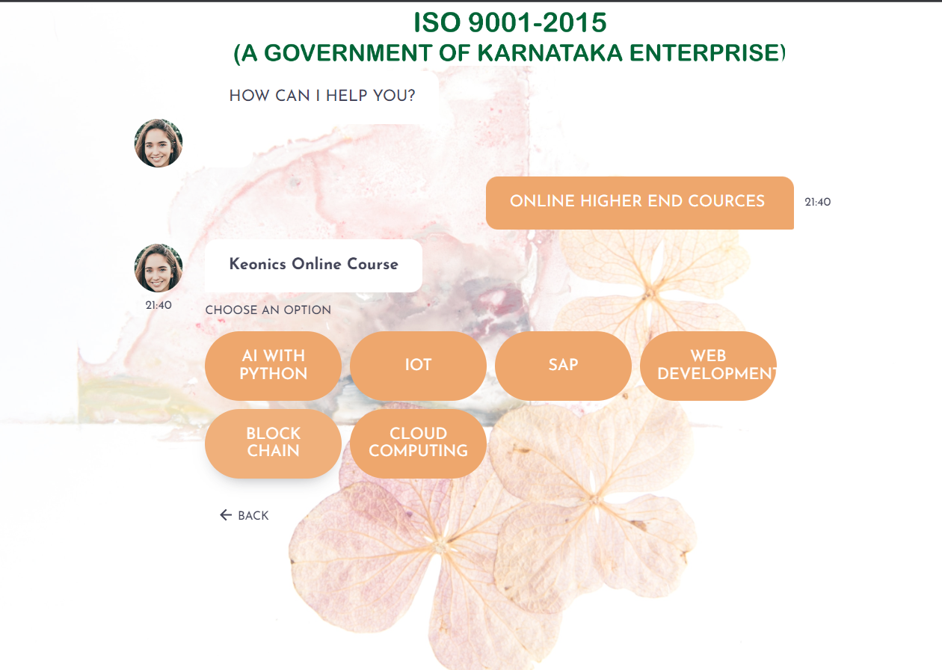
CHATBOT DIALOGUE FLOW
After clicking on online higher end courses we get courses list

Slide 7
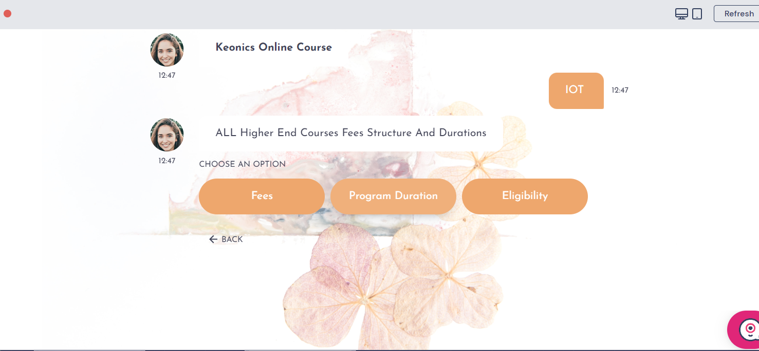
CHATBOT DIALOGUE FLOW
After selecting Higher end courses we can know the eligibility, program, Fees.

Slide 8
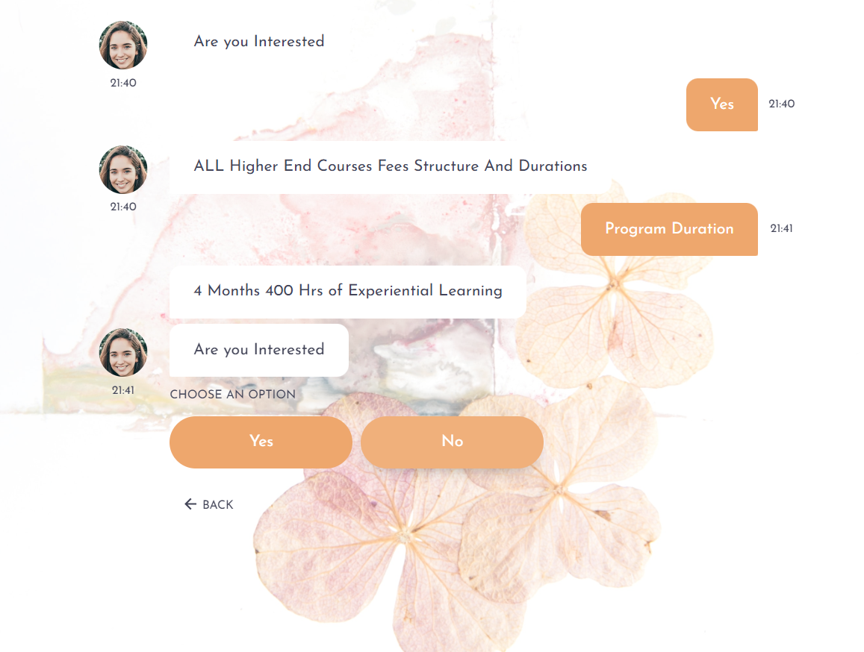
CHATBOT DIALOGUE FLOW
After selecting the course Fees Structure and Duration

Slide 9
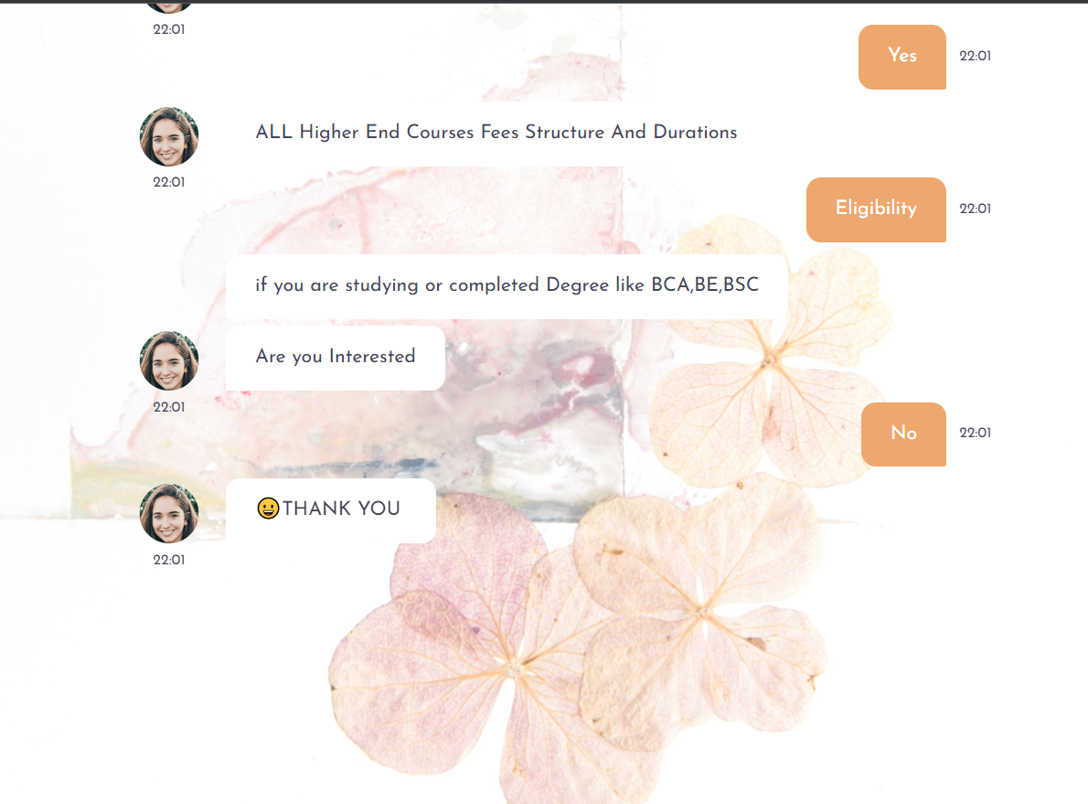
CHATBOT DIALOGUE FLOW
Now in this we will select eligibility and goes on

Slide 10
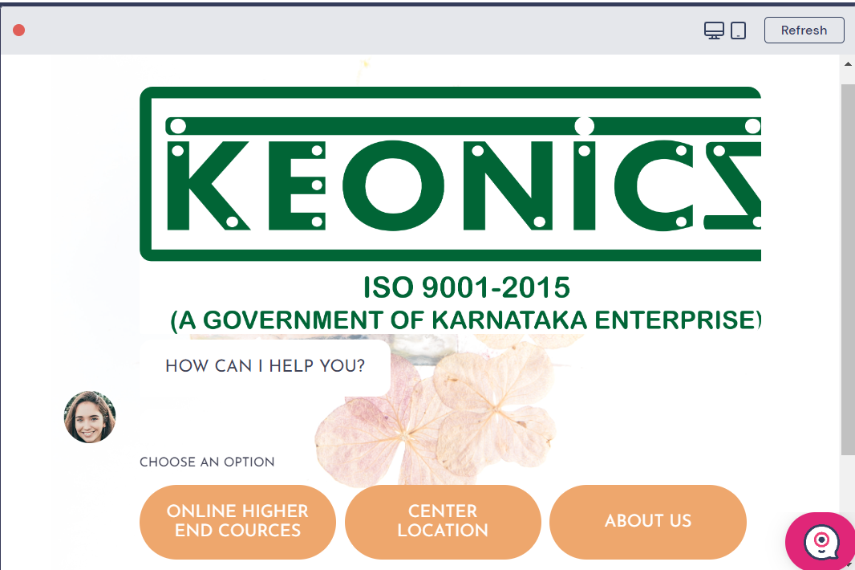
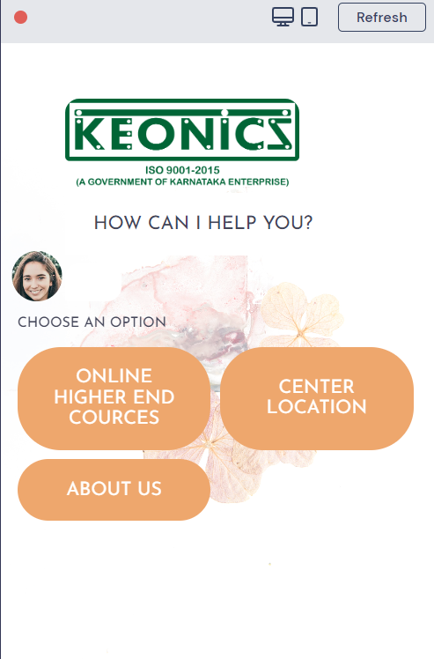
This is how the chatbot looks in Mobile and Laptop

Slide 11
Let's Interact with our Chatbot in Real

Slide 12
BENEFITS
We can know how many course students are interested in which course.
Students can know the eligibility and admission procedure.
And students can find the location of Keonics for more information.

Slide 13

THANK YOU

